Slide 1
Attributes & Keys
2.1

Slide 2

Moving on from Conceptual Models
Conceptual models
Brainstorming
Business process discovery
Final product: Conceptual Data Model (CDM)
Logical models
More formal; provides a template for the “real” database
Fully describes entities
Will be refined for efficiency before implementation
Final product: Entity Relationship Diagram (ERD)
Physical models
Database implementation
Exact process depends on the RDBMS that is chosen
Final product: A relational database

Slide 3

Describing Entities with Attributes
Think of attributes like adjectives – they describe an instance of an entity
Consider the entity “User”

Slide 4
Discovering Attributes
Where do you go to discover attributes?
Business Documentation​
System requests​
System descriptions​
Proposals​
Competitive Analysis​
Find and dissect similar products​
Interviews with Stakeholders​
Should have been done with the systems development process​
Stakeholders: inside and outside the organization​
Your own lived experience
Consider every form and application you have ever filled out in your life​

Slide 5
Atomic Attributes in Entities
Break Down Attributes into Discreet Components
“Name”
First name
Last name
Middle name
Honorific
Suffix
“Full legal name”
“Elliott Jr.”
Leave off the suffix “Elliott”
Combine last name and suffix “ELLIOTTJR”
Separate last name and suffix into two fields “Elliott” and “Jr.”

Slide 6

Atomic Attributes in Entities
Break Down Attributes into Discreet Components
“Address”

Slide 7

Cultural & Regional Implications
Consider where your data will be collected and examined as part of the design process
Cultural norms for naming conventions
“First Name” + “Last Name”
first_name > given_name
last_name > family_name
middle_name? Not required
preferred_name (nickname, etc.)
Regional differences in other attributes
“State” vs. “Province” vs. “Region”
Country code in phone numbers
“ZIP Code” (US) vs. “Postal Code” (Canada, UK, etc.)

Slide 8
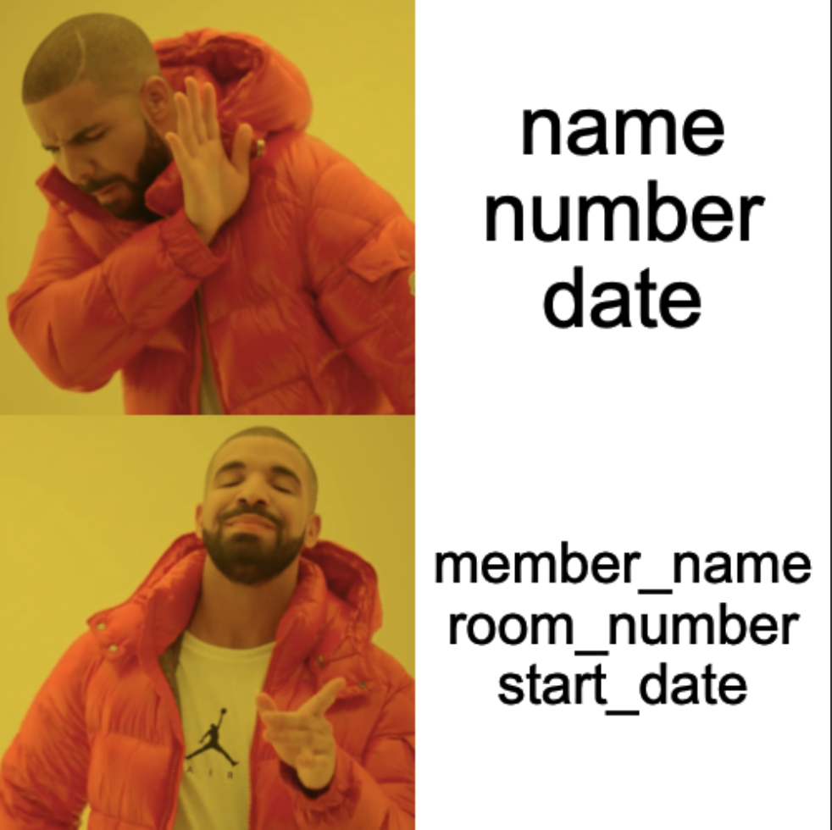
Other Rules for Attribute Names
Don’t use reserved or keywords:
name
number
date
Use more descriptive terms:
member_name
room_number
start_date

Slide 9
Data Types
Data types are generally not required in a logical data model, but I recommend you start thinking about them
Common data types in RDBMS
Integer (INT) – whole numbers
Float or Double - fractional numbers where precision is less necessary
Decimal (DEC) – fractional numbers where precision and scale are needed (e.g. currency)
Char/Varchar/Text – strings of text
CHAR: fixed length (every record contains the same # of characters)
Example: ISO country codes (“US”, “CN”, “UK”, “SE”)
VARCHAR: variable length with a limit (normally 255 characters; can be shorter)
TEXT: Large blocks of text; uses more storage
TINYTEXT, MEDIUMTEXT, LONGTEXT, etc…
Boolean (BOOL)
DateTime/Date/Time/Timestamp
Consider accuracy and time zone awareness
Variable based on RDBMS

